Slide 1
Causal Inference and Its Application in Security
Huang Xiao
Lst. IT Sicherheit (I20)
Technische Universität München
Presented on 29th August 2012

Slide 2
Outline
What is causality?
Motivation, Example, Intuition.
Causal Bayesian Network
Theoretical background, problem statement
Approach: Copula based Causal BN
Copula functions
PICM Structure learning
Empirical study on IDS dataset
KDD99 Dataset, experimental results
Future work and wrap up.

Slide 3

Approx. 20 min

Slide 4
What is (probabilistic) causality?
From Wikipedia:
Causality (also referred to as causation) is the relationship between an event (the cause) and a second event (the effect), where the second event is understood as a consequence of the first.
A example question in real life:
Does smoking causes lung cancer?
YES, IT MIGHT DO!
Notes:
So, first of all, we gotta start from the ground up to understand what’s the causality

Slide 5
In a probabilistic view
Does smoking causes lung cancer?
Smoking will increase the probability of getting lung cancer.
Notes:
Let’s look at it in a probabilistic view.

Slide 6
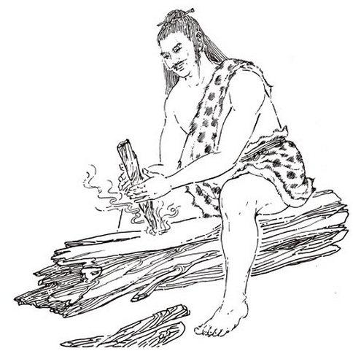
Why do we need causality?
Discover the rules of the nature.
Reasoning
Decision-making
Fundamental difference with machine learning

Slide 7
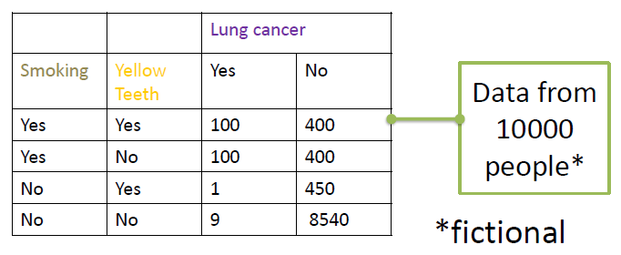
Association
Now we want to find out what causes lung cancer.
I. Data observations

Slide 8
Three variables
Smoking
Yellow teeth
Associations?
Lung cancer

Slide 9
Measuring Association
Information theory
Mutual Information
Statistics
Pearson(linear) correlation
Spearman correlation (continuous variables)
Effect size (between two variables)
Many others..
Notes:
In statistics, an association is any relationship between two measured quantities that renders them statistically dependent.^{[1]} The term "association" refers broadly to any such relationship, whereas the narrower term "correlation" refers to a linear relationship between two quantities.
There are many statistical measures of association that can be used to infer the presence or absence of an association in a sample of data. Examples of such measures include the product moment correlation coefficient, used mainly for quantitative measurements, and the odds ratio, used for dichotomous measurements. Other measures of association are the distance correlation,tetrachoric correlation coefficient, Goodman and Kruskal's lambda, Tschuprow's T and Cramér's V

Slide 10
From the data…
Obviously…
Yellow teeth and lung cancer are associated.
But…
Bleaching the teeth does not help reduce the probability of getting lung cancer.
Correlation does not imply Causation!

Slide 11
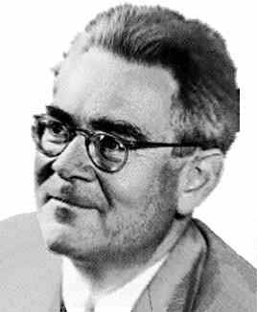
Common Cause Principle
If A and B are correlated, then A causes B or B causes A or they share a latent common cause.
Z
or
A
B
or
A
B
A
B
It links causation with probability
HANS REICHENBACH (1891 - 1953)

Slide 12
Conditional Independence
Z
Z
Z
Z
A
B
A
B
A
B
A
B
Equivalent class
V-structure
Associations:
Dep(A, Z | Ø)
Dep(Z, B | Ø)
Dep(A, B | Ø)
Ind(A, B | Z)
Associations:
Dep(A, Z | Ø)
Dep(Z, B | Ø)
Ind(A, B | Ø)
Dep(A, B | Z)

Slide 13
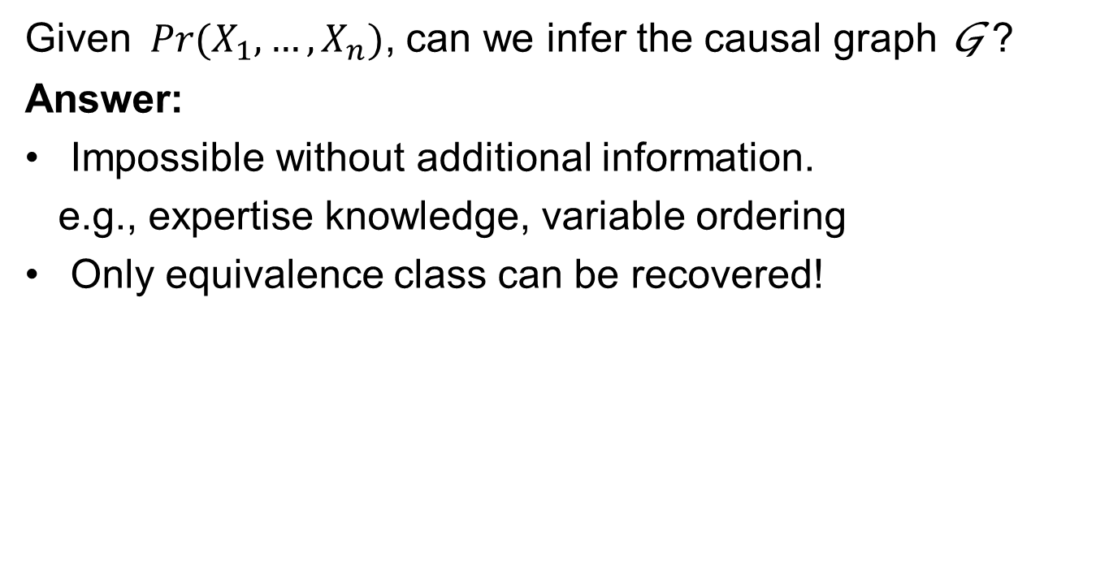
Possibility of Causal Inference?
Given$Pr(X_{1},…,X_{n})$, can we infer the causal graph G ?
Answer:
Impossible without additional information.
e.g., expertise knowledge, variable ordering
Only equivalence class can be recovered!

Slide 14
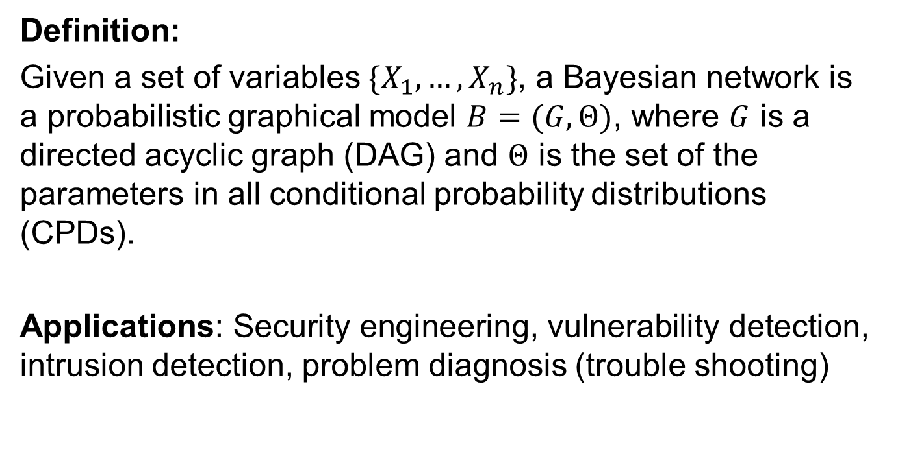
Bayesian Network
Definition:
Given a set of variables $\{X_{1},…,X_{n}\}$, a Bayesian network is a probabilistic graphical model $B=(G, Θ)$, where $G$ is a directed acyclic graph (DAG) and $Θ$ is the set of the parameters in all conditional probability distributions (CPDs).
Applications: Security engineering, vulnerability detection, intrusion detection, problem diagnosis (trouble shooting)

Slide 15
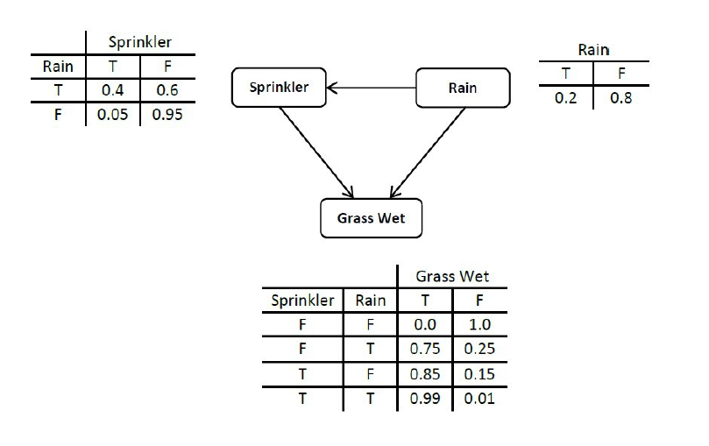
Example

Slide 16
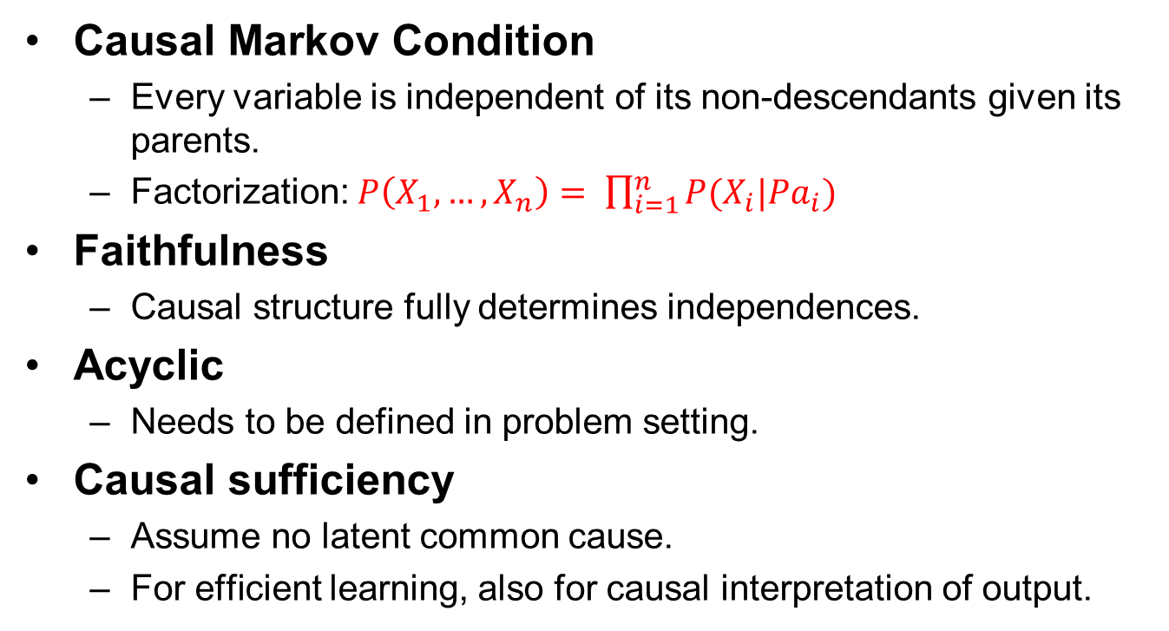
Assumptions
Causal Markov Condition
Every variable is independent of its non-descendants given its parents.
Factorization: $P\left(X_{1},…,X_{n}\right)= \prod_{i=1}^{n}{P(X_{i}|{Pa}_{i})}$
Faithfulness
Causal structure fully determines independences.
Acyclic
Needs to be defined in problem setting.
Causal sufficiency
Assume no latent common cause.
For efficient learning, also for causal interpretation of output.

Slide 17
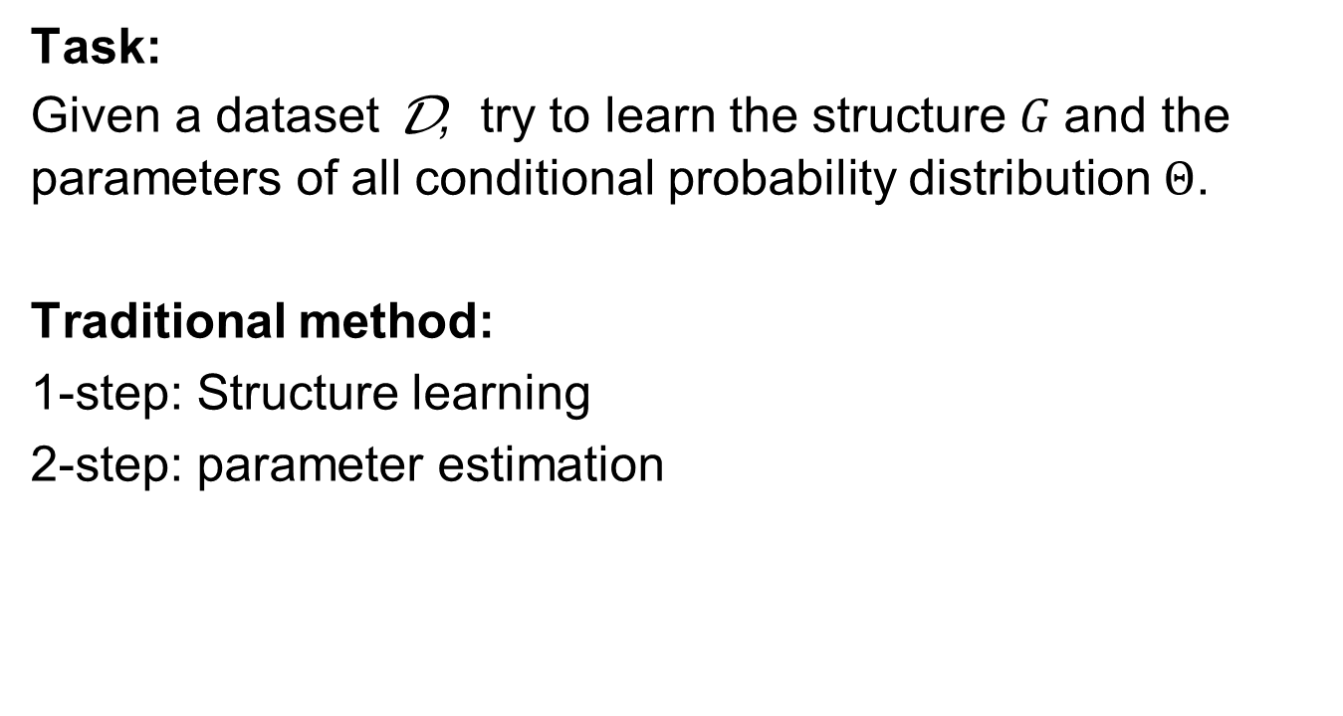
Learning Bayesian Network
Task:
Given a dataset D, try to learn the structure $G$and the parameters of all conditional probability distribution $Θ$.
Traditional method:
1-step: Structure learning
2-step: parameter estimation

Slide 18
Structure learning
I. Constraint based
Conditional independence tests in data and find a DAG faithful to them.
Methods:
SGS
PC
TPDA
CPC
II. Score based
Find a DAG maximizing the posteriori probability given the data.
Methods:
K2
Sparse Candidate
GBPS
And many more..
III. Hybrid
Methods: MMHC, CB, ECOS

Slide 19
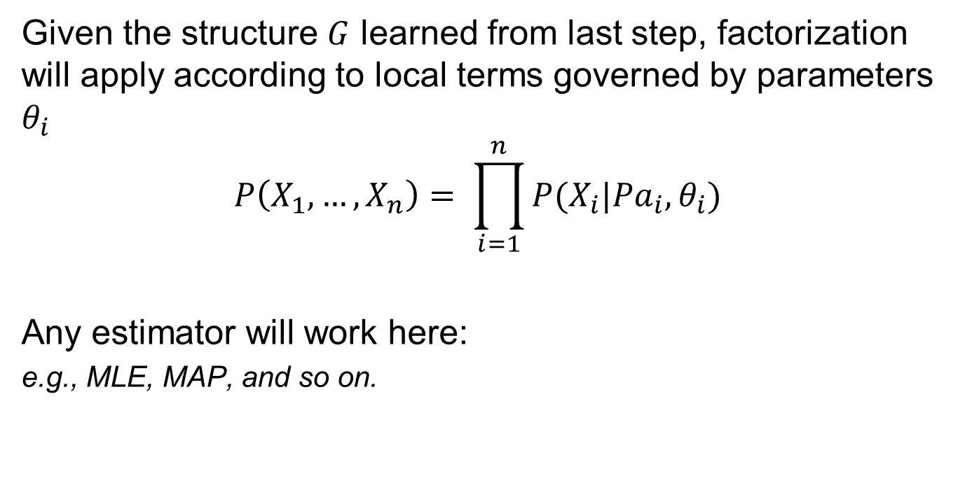
Parameter Estimation
Given the structure $G$ learned from last step, factorization will apply according to local terms governed by parameters $θ_{i}$
$$P\left(X_{1},…,X_{n}\right)= \prod_{i=1}^{n}{P(X_{i}|{Pa}_{i}, θ_{i})}$$
Any estimator will work here:
e.g., MLE, MAP, and so on.

Slide 20
But…
Only equivalence class can be obtained!

Slide 21
Problems in BN Learning
Search space is exponentially large in high dimension
Too many conditional tests
Local minimum
Parametric form needed
Missing values

Slide 22
Copula Treatment – Sklar’s theorem
[Sklar 1959] Let be any multivariate distribution over real-valued random variables, then there exists a copula function such that
where is marginal cumulative density distribution of variable and furthermore if each is continuous then is unique.
Copula functions

Slide 23
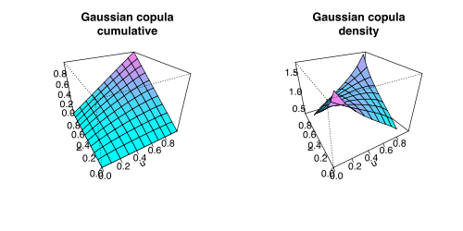
A quick sample: Gaussian Copula
Gaussian Copula is a widely explored Copula function:
:standard normal distribution
: zero mean normal distribution
: correlation matrix.
Bivariate cumulative and density
distribution of Gaussian
Copula with correlation ρ = 0.4

Slide 24
Advantages of Copula Functions
Totally free choice of marginal distributions of each variable.
Transform any joint distributions into a Gaussian.
Non-parametric estimators are allowed, which is an ease for missing values. e.g., kernel density estimator.

Slide 25
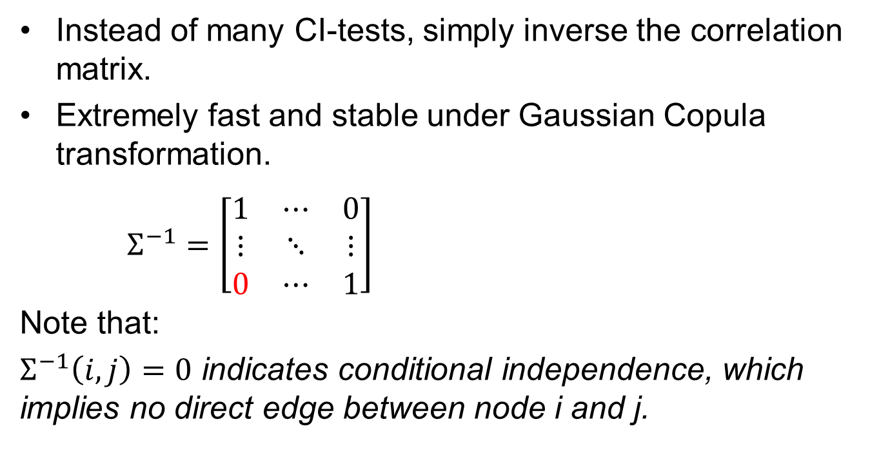
Partial Inverse Correlation Matrix
Instead of many CI-tests, simply inverse the correlation matrix.
Extremely fast and stable under Gaussian Copula transformation.
$Σ^{−1}=\left[\begin{matrix}1 & ⋯ & 0 \\ ⋮ & ⋱ & ⋮ \\ 0 & ⋯ & 1\end{matrix}\right]$
Note that:
$Σ^{−1}\left(i, j\right)=0$ indicates conditional independence, which implies no direct edge between node i and j.

Slide 26
From Skeleton to PDAG
Find V-structures
Constraint propagation
No new V-structure!
Detrianglation

Slide 27
Finally, we recovered a causal graph model together with its quantitative factors (probabilistic parameters).

Slide 28
An application on Intrusion Detection System
Dataset: KDD99
42 variables in total, e.g.,
# of connections to the same host in the past two seconds
% of connections that have “REJ” errors
# of failed logins
Protocol type
21 attack types (but 60% are DOS attack)
Training size: 1000

Slide 29
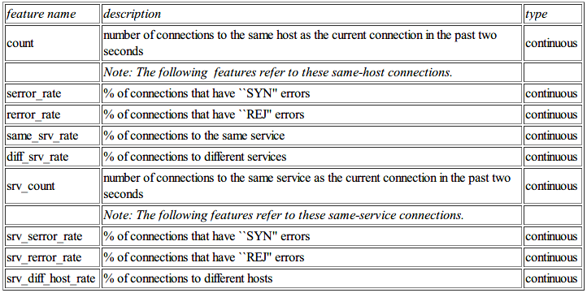
10 Features

Slide 30
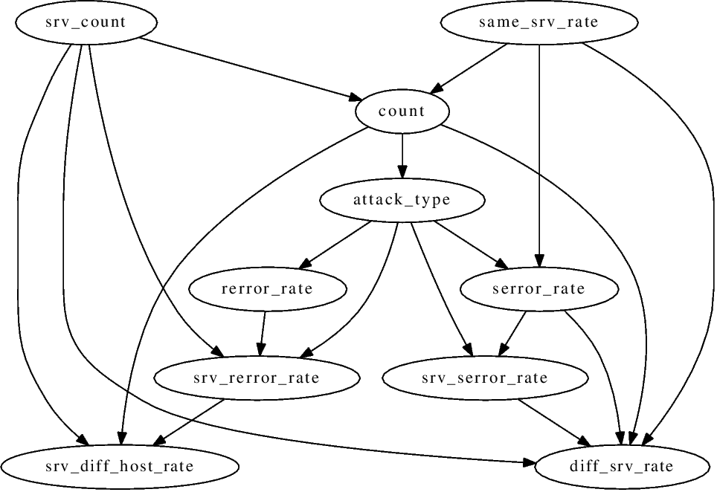
Inferred Causal Graph
10 Nodes only

Slide 31
Other datasets
DARPA (1998)
From MIT Lincoln Labs, simulated in military network environment
Both KDD99 and DARPA are too old..
ISCX (2012)
Gathered data in one week
From University of New Brunswick
Total 85.33 GB
Already got it!

Slide 32
Future work
Now Copula Functions only work well for the continuous case.
Most security scenarios are hybrid (both discrete and continuous data, which is still an open problem)
Real-time causal network updating (DBNs)
Dynamic feature selection
Nonlinearity
E.g., stochastic process, kernel tricks
Cyclic Bayesian Network (feedback loop)

Slide 33
Thanks

